Slide 1
Session 2: How can EUnetHTA predict and assist European health systems prepare for potentially disruptive innovation?
Notes:
I will contribute to this session with the view of WP4. The horizon scanning activity that we are currently working on within our work package is being lead by my colleague Vigdis Lauvrak.

Slide 2
Session 2: How can EUnetHTA predict and assist European health systems prepare for potentially disruptive innovation?
WP4 LP, Ingvil Sæterdal & Vigdis Lauvrak, Norwegian Institute for Public Health
Notes:
I will contribute to this session with the view of WP4. The horizon scanning activity that we are currently working on within our work package is being lead by my colleague Vigdis Lauvrak.

Slide 3

Disruptive technology
An innovation that improves a product or service in ways that the market does not expect, typically first by designing for a different set of consumers in a new market, and later by lowering prices in the existing market¹.
Image downloadedd from Pixabay
¹Definition derived from 2018 HTAi Policy Forum background paper
Notes:
In WP4 we currently define disruptive technology in line with the background paper for this year’s HTAi Policy Forum meeting.
A potential disruptive or transformative health technology will allow a new group of patients access to a treatment or service that has previously only been accessible to a limited group of patients (due to high costs and/or complexity of service).
Vi endre måten vi behandler pasienter på, kan ikke alltid forutse hvilke teknologier det vil gjelde, slå bena ut av annen teknologi, frigjøre ressurser til annen behandling. Før teknologien har noe for seg.
The mass-produced automobile was a disruptive innovation, because it changed the transportation market, whereas the first thirty years of automobiles did not.
A transformative health technology may be defined as a technology that may have large impact on health status, health care systems and transform the way care is provided.

Slide 4
Topic Identification, Selection and Prioritisation (TISP)
TISP
Development of draft recommendations
  Work group consisting of authors from 9 WP4 partners, reviewers from 22 WP4 partners
  Coordination by Vigdis Lauvrak, WP4 Lead Partner, NIPHNO, Norway
Notes:
- WP4 has developed draft recommendations for horizon scanning, including a workflow for topic identification, selection and prioritisation.

Slide 5
WP EUnetHTA TISP draft pilot – identification
Submission from industry
Existing Horizon scanning systems
List from partners #1
List from partners #2
Proposals from other stakeholders
Regulators
List from partners #3
List from partners #4
Proposals from EUnetHTA partners
WP4 TISP secretariat
Other tech & Pharma
Notes:
The pilot will be limited to serve Joint and collaborative assessments of pharmaceuticals and medical devices/IVDs
This picture shows our draft recommends for the identification process within eunethta.
Vil nevne identification sources + sources fra tabellen som er tenkt brukt post 2020
Selection criteria for the pilot: pharmaceuticals for joint assessment in accordance with the EU proposal (medicinal products undergoing central marketing authorisation procedure) og innovative devices or IVDs for assessments within WP4 (those of relevance to our partners)
Selection criteria for Devices will be broader than the EU-proposal with regard to timeline (both initial assessment and re-assessment ( that is JA and CA)) will be within the scope of the pilot (and is within the scope of WP4 OT)
and the prioritization and initiation of assessments.
Prioritization criteria:
Unmet medical need
Potential impact on patients, public health or healthcare systems
Relevance to a large number of member states

Slide 6
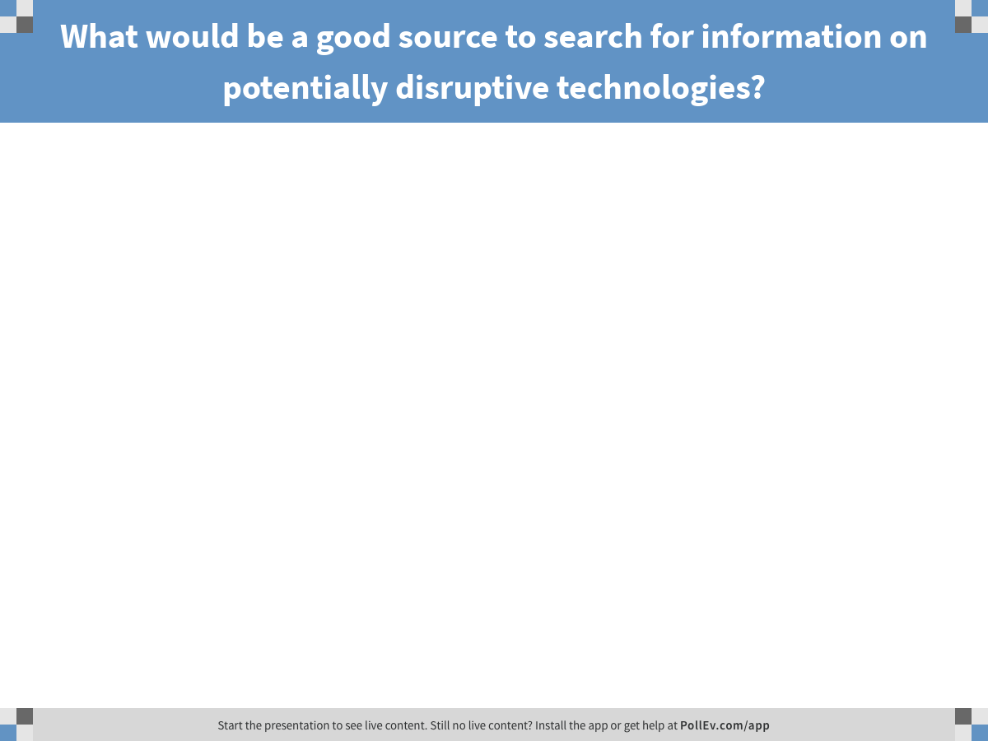
Notes:
Poll Title: What would be a good source to search for information on potentially disruptive technologies?
https://www.polleverywhere.com/free_text_polls/iPzyqxk46SHcOFU

Slide 7

Horizon scanning, Topic identification, selection and prioritisation (TISP) along the lifecycle
Re-assessment
HTA/Re-assessment
Use of technology in health care
INDUSTRY
Early Dialogues
Scienfic
Advice
Rapid
REA
REGULATORS
OTHER
STAKEHOLDERS
Assessment for market authorization
Additional data
collection
TISP
TISP
TISP
TISP
Time line of innovation
Notes:
How can EUnetHTA use horizon scanning to identify potentially disruptive technologies?
We intend to propose a Horizon scanning system that support planning, timeliness and relevance of joint HTA activities and to reduce unnecessary duplication of work.
Ideally a horizon scanning system should provide information for HTA activities along the product life cycle in order to assess «the disruptiveness» of a potential transformative technology. The HS system should provide information to support HTA activities:
Early (before the technology is available for broad use)
Initial (when the technology becomes available)
After introduction of the technology (the system should follow the technology to ensure re-assessment)

Slide 8

Consultation of EUnetHTA draft recommendations and pilot: June 2018
Image downloaded from European GNSS Agency - Europa EU
Notes:
Slide 7: The TISP recommendations will be shared for a stakeholder consultation which will include patient organisations, payers/decision makers, health care providers, regulators and industry. The consultation will take place in June and the recommendations will be piloted in this autumn.

Slide 9
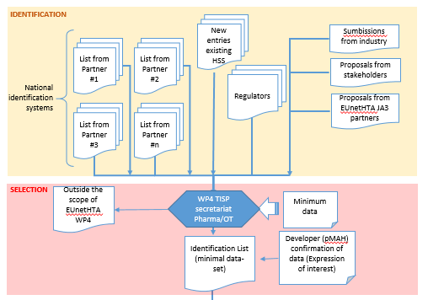
WP EUnetHTA TISP pilot – identification and selection
Draft workflow WP4 TISP, May 2018
Notes:
The pilot will be limited to serve Joint and collaborative assessments of pharmaceuticals and medical devices/IVDs
This picture shows how we recommend the identification and selection process within eunethta.
Vil nevne identification sources + sources fra tabellen som er tenkt brukt post 2020
Selection criteria for the pilot: pharmaceuticals for joint assessment in accordance with the EU proposal (medicinal products undergoing central marketing authorisation procedure) og innovative devices or IVDs for assessments within WP4 (those of relevance to our partners)
Selection criteria for Devices will be broader than the EU-proposal with regard to timeline (both initial assessment and re-assessment ( that is JA and CA)) will be within the scope of the pilot (and is within the scope of WP4 OT)

Slide 10
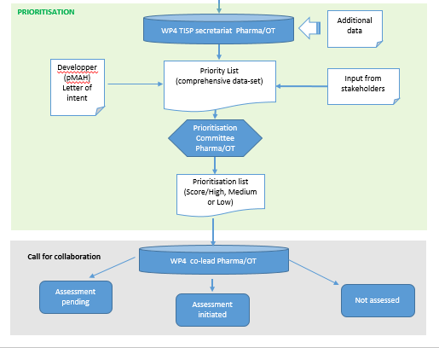
WP EUnetHTA TISP pilot – prioritisation and initation of assessments
Draft workflow WP4 TISP, May 2018
Notes:
and the prioritization and initiation of assessments.
Prioritization criteria:
Unmet medical need
Potential impact on patients, public health or healthcare systems
Relevance to a large number of member states

Slide 11
How can EUnetHTA predict and assist European health systems prepare for potentially disruptive innovation?
Chantal Bélorgey
HAS, France
WP5 lead

Slide 12
Disruptive innovation
Innovation = NEW, unmet need, added value
Disruptive innovation :
  improves dramatically
    patient’s health (preventing/treating/accompanying patient)
    OR public health
  OR changes the health care organisations
  AND/OR decrease health care cost while similar impact on health.
=> Need for proper clinical evidence to allow access
=> Need for real world evidence to show progress and maintain access

Slide 13
Uncertainty, access to innovation
Clinical effectiveness
UNCERTAINTIES?
Efficacy
Safety
Robust data (RCT) and real world evidence required
Patient involvement; Early Reassessment
Emerging
innovation
Exceptionnally: temporary appraisal/ coverage?
A dynamic assessment
Adapted from Nice!

Slide 14
How can EUnetHTA support innovation and assist Health systems?
  Identification
Horizon scanning
Early dialogues
  Improvement of submitted data quality
  Accelerated assessments
Joint assessments
PLEG
  Real world data collection
  Reassessment
Joint reassessment?
Notes:
In that context, EunetHTA is able to support dynamic innovation and to assist health systems
- 1st by identifying and anticipating the arrival of disruptive innovations through the HS system we are developing
2ndly through early dialogues that EunetHTA offers to the industry, and which allow the improvement of quality of data that will be submitted to HTA bodies
3rdly Joint assessments is really supposed to accelerate access and is of added value for innovative products
Furthermore, The Post Launch Evidence Generation mecanism of the strand b of WP5 proposes a better coordinated position on real world data collection that will be, for sure, required to confirm the initial assessment
And lastly reassessment could be also a possible coordinated activity.

Slide 15
Objectives of Early Dialogue (ED)
To provide advice on product development plans.
To improve the quality and appropriateness of the data produced by the developers that may ultimately lead to well-informed regulatory and HTA and reimbursement decisions in a timely manner.
To optimize the interaction with regulators for medicinal products,

Slide 16
Disruptive innovations are critical candidates for ED and PLEG
Pre-launch and post-launch data should be discussed during an ED
  More complex development
    not prevent generation of comparative data
    Agreement on minimum set of evidence
      time of launch and time of the re-assessment
Disruptive innovation identified via EUnetHTA HS should systematically go through ED process.
i.e PRIME
see prioritisation criteria EDWP
PLEG: ½ pilots

Slide 17
Prioritization is key.
Collaboration where more added value.
Identify disruptive innovations
Candidates along their life cycle: ED,JA, PLEG

Slide 18
Assisting healthcare systems to prepare for innovation – Reflections from a regulatory perspective
2018 EUnetHTA Forum, 25 May 2018
Cologne, Germany
Presented by Michael Berntgen
Head of Product Development Scientific Support Department

Slide 19

Identifying technologies that are coming into the healthcare systems
Different elements are taken into consideration for the approach to horizon scanning:
Objectives / desired impact
Scope of technologies / interventions
Observation period (“distance to horizon”)
Data sources and detection methodology
Triage
Reporting mechanisms
Decision makers use different methodologies and for various purposes

Slide 20
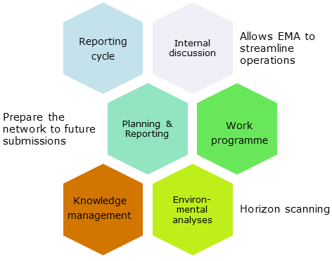
EMA experience with business analysis and forecasting
To support planning for “the near future” (operational workload, expertise needed) based on type of applications, therapeutic areas, medicinal products, indications etc.
To detect early important (and potentially “disruptive”) technologies with impact on healthcare systems
To facilitate development activities by identifying ‘road blocks’, signpost companies to interaction opportunities and support reviews of trends

Slide 21
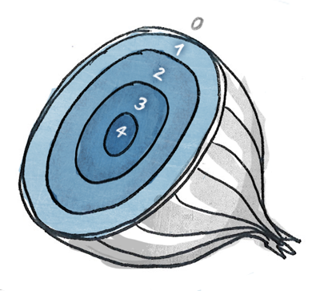
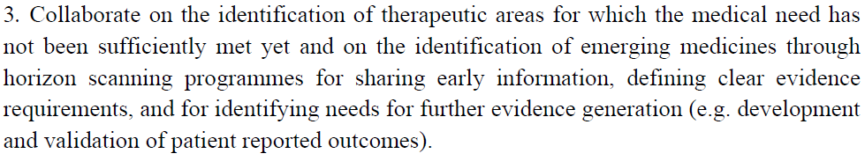
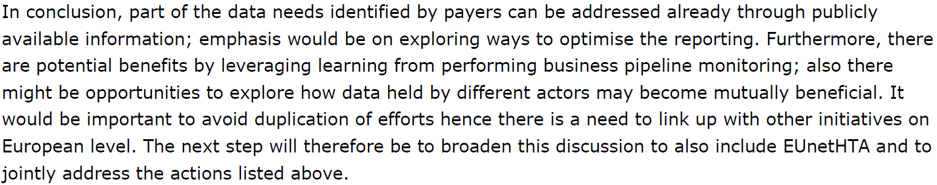
Reference points for collaboration on “Horizon Scanning”
HTA Network Reflection Paper on "Synergies between regulatory and HTA issues on pharmaceuticals“
EMA-EUnetHTA work plan 2017-2020
EMA – Payer Community meeting

Slide 22



Opportunities for collaboration across decision makers in the “horizon scanning” space
Products under regulatory assessment
Improved reporting on regulatory milestones incl. relevant data fields to inform subsequent decision makers
Products to be submitted for assessment by decision makers
Mapping of existing and planned horizon scanning activities
The wider horizon – products in development and beyond
Collaboration in the context of strategic initiatives
Optimise regulatory assessment reports for subsequent use by HTAs and payers (e.g. clarity and completeness)
Explore opportunities to make pre-submission information available incl. feasibility to increase predictability of upcoming submissions
Use of available information on regulatory development support by HTAs and payers
Contribution to discussions on unmet medical need

Slide 23
How can players along the technology lifecycle work together to support the introduction of innovative health technologies
Horizon scanning
Evidence genera-tion plan
Market entry
Post-licensing evidence
Collaboration on topic identification and prioritisation by various players
Early flag of innovation that would benefit from closer engagement across decision makers
e.g. parallel consultation (scientific advice) involving various decision-makers to ensure evidence generation meets different needs
e.g. readiness for subsequent decision making in a timely manner, respecting different remits
e.g. preparedness of patient registries to collect relevant information in a robust manner
Collaboration between decision makers on Horizon Scanning activities can enable better preparedness of the healthcare systems for development and introduction of innovation.

