Slide 1
2021 EUnetHTA Forum
Thursday 15 April 2021
Welcome

Slide 2
Housekeeping and welcome
Lauren Law, ZIN
Marcus Guardian, ZIN

Slide 3
Information for attendees
Entering the meeting:
Please ensure you have logged in with your name, surname, organisation and country i.e. Ali Hussain (ZIN, The Netherlands). You can rename yourself after you have logged in.
Please do not try switching your webcam on. Only presenters are able to do so.
Participating in polleverywhere:
Throughout the meeting, you may be asked to participate in a poll.
More information will follow on the polleverywhere slide.

Slide 4

Information for attendees
Questions:
To ask questions, you may:
  Use the Q&A box
Responses to all questions will be coordinated by the Chairs and will be taken at the end of each item.
You may also “like” other people’s questions, which will push the question further up the list.
Please note: The chat function, used in regular Zoom meetings, is disabled for this webinar. Please use the Q&A box for your questions.
This meeting will be recorded.

Slide 5
Information for attendees
Technical issues:
If you experience problems with Zoom during the meeting, please:
  Go to www.zoom.com and search for help.
  Contact mtenberg@zinl.nl or call Merle Tenberg on +31 6 51 06 80 53 for support (You may wish to take a picture of these contact details).

Slide 6

Poll everywhere information
3. Scan the QR code below
Throughout the meeting we will have poll questions for you. To join please follow one of these steps:
1. You can respond at PollEv.com/eunethtaeven016 OR
2. Audience texts EUNETHTAEVEN016 to +31 970 0449 8375 to join the session, then they text a response.

Slide 7
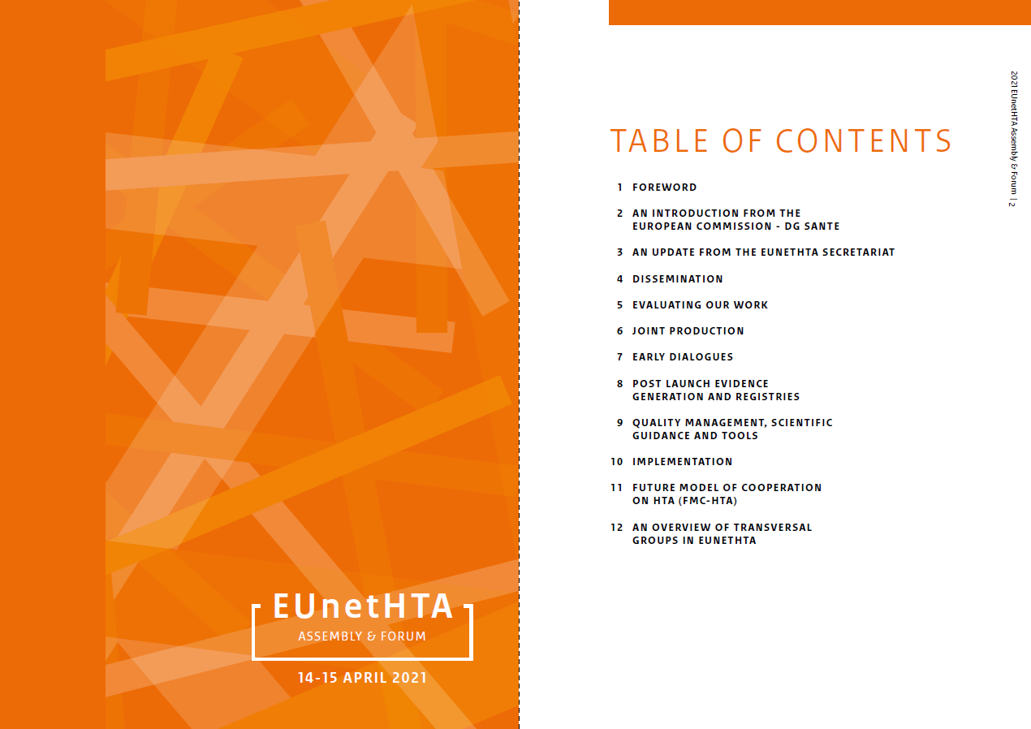
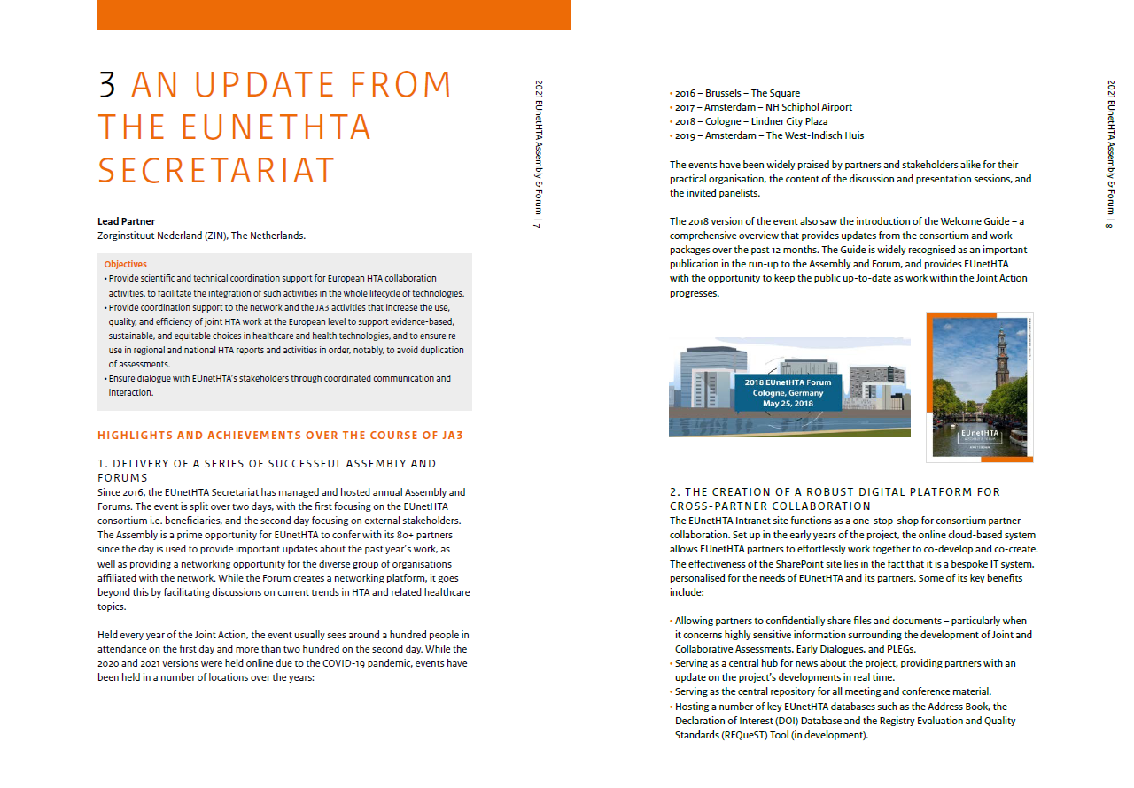
The Welcome Guide
The Welcome Guide, which includes a comprehensive introduction to the day’s proceedings, has been shared with all attendees beforehand.
You can access the Guide by going to https://eunethta.eu/2021-forum/
If you would like more information on any of the updates presented today, please contact the Secretariat at eunethta@zinl.nl. You may also choose to contact the partner concerned directly.

Slide 8
Welcome
Marcus Guardian, ZIN

Slide 9
1. Welcome from the Chair
Niklas Hedberg, TLV

Slide 10

Notes:
Poll Title: Do not modify the notes in this section to avoid tampering with the Poll Everywhere activity.
More info at polleverywhere.com/support
What city are you joining from today?
https://www.polleverywhere.com/free_text_polls/g1kpkMtaKQ1zBWDxiA2Vj

Slide 11

Notes:
Poll Title: Do not modify the notes in this section to avoid tampering with the Poll Everywhere activity.
More info at polleverywhere.com/support
How long have you been working from home?
https://www.polleverywhere.com/free_text_polls/CoZjFrkI9kcdrfHHTcDuJ

Slide 12
2. Today’s agenda
Niklas Hedberg, TLV

Slide 13
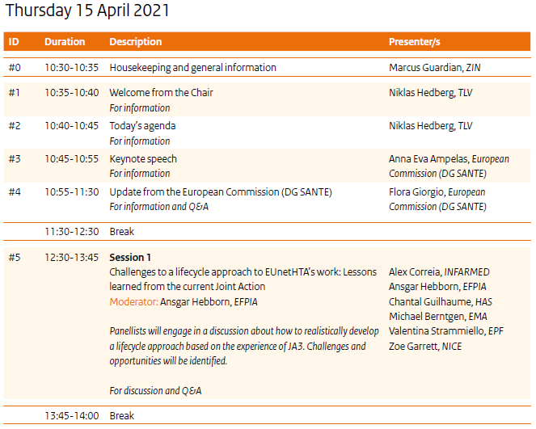

Slide 14
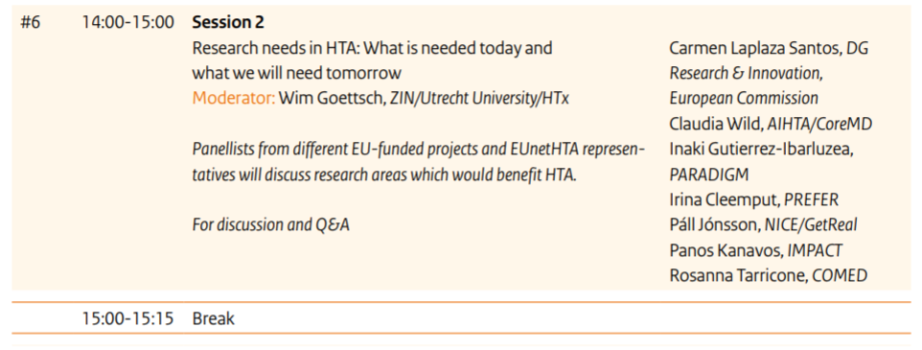
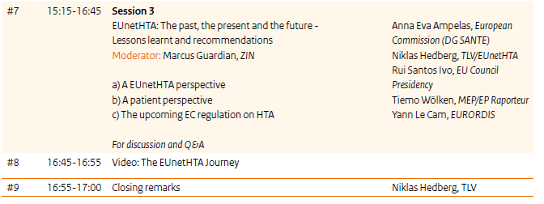

Slide 15
3. Keynote speech
Anna Eva Ampelas, European Commission (DG SANTE)

Slide 16
EUnetHTA –
Working together for the future
Anna Eva Ampelas
DG SANTE, Head of unit
B6 - Medical devices and HTA
EUnetHTA Forum, 15 April 2021

Slide 17
4. Update from the European Commission (DG SANTE)
Flora Giorgio, European Commission (DG SANTE)

Slide 18

Thank you
© European Union 2020
Unless otherwise noted the reuse of this presentation is authorised under the CC BY 4.0 license. For any use or reproduction of elements that are not owned by the EU, permission may need to be sought directly from the respective right holders.
Slide xx: element concerned, source: e.g. Fotolia.com; Slide xx: element concerned, source: e.g. iStock.com
Notes:
Update/add/delete parts of the copy right notice where appropriate.
More information: https://myintracomm.ec.europa.eu/corp/intellectual-property/Documents/2019_Reuse-guidelines%28CC-BY%29.pdf

Slide 19
Break

Slide 20
5. Session 1
Challenges to a lifecycle approach to EUnetHTA’s work: Lessons learned from the current Joint Action
Moderator: Ansgar Hebborn, EFPIA

Slide 21
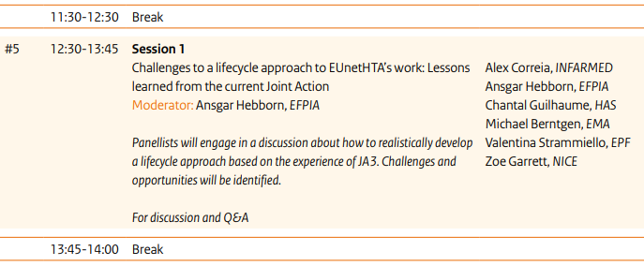
Session 1
Zoe Garrett, EUnetHTA/NICE
Ansgar Hebborn, EFPIA/Roche
Valentina Strammiello, European Patient Forum (EPF)
Alex Correia, Infarmed (Portugal)
Chantal Guilhaume, HAS (France)
Michael Berntgen, EMA

Slide 22
Panelists
(in order of their presentations)
1. Zoe Garrett, EUnetHTA/NICE (UK)
2. Ansgar Hebborn, EFPIA/Roche
3. Valentina Strammiello, European Patient Forum (EPF)
4. Alex Correia, Infarmed (Portugal)
5. Chantal Guilhaume, EUnetHTA/HAS (France)
6. Michael Berntgen, EMA

Slide 23
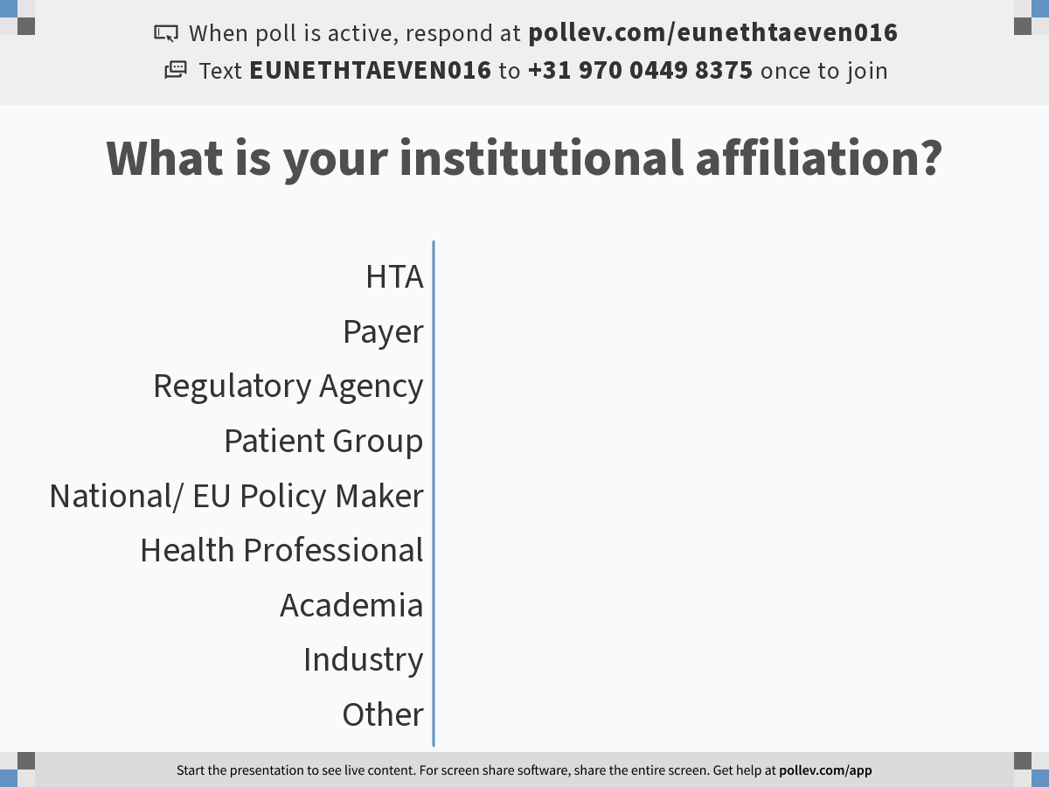
Notes:
Poll Title: Do not modify the notes in this section to avoid tampering with the Poll Everywhere activity.
More info at polleverywhere.com/support
What is your institutional affiliation?
https://www.polleverywhere.com/multiple_choice_polls/ySbSndWuBh7416gRvAdvY?flow=Default&onscreen=persist

Slide 24
Challenges to a lifecycle approach to EUnetHTA’s work: Lessons learned from the current Joint Action
Zoe Garrett, Vice-Chair EUnetHTA Executive Board
National Institute Health and Care Excellence (NICE)
Notes:
Chapter slide

Slide 25
Background
An objective of EUnetHTA is to support voluntary cooperation between HTA agencies by providing the scientific and technical mechanism of a permanent European cooperation on HTA.
To meet this objective we initiated a piece of work to develop the underlying scientific and technical principles for a future model of HTA cooperation.
The work compiles the outputs of JA3 into a report (a White Paper) that describes the way we worked in JA3, what we have achieved, what we have learnt and what we recommend for the future.
Caveats to this presentation:
The report is still draft undergoing consultation and discussion
This presentation has a pharmaceutical focus
Only a small selection of findings are presented

Slide 26
Joint HTA activities should take place along the lifecycle of the health technology
Early Dialogues
Joint Assessment
Post Launch Evidence Generation
Horizon Scanning
Early Dialogues
Joint Assessment
Post Launch Evidence Generation
Re-Assessment

Slide 27
Horizon scanning
In JA3 EUnetHTA carried out a pilot project on topic identification
Information that is available to share or is publicly available is not sufficient for timely topic identification – a dedicated process is required
It should be possible to leverage existing horizon scanning activities and initiatives - for pharmaceuticals EMA is a valuable collaborator but collaboration was hindered by the EUnetHTA JA3 cooperation framework
Horizon scanning plays an important role in ensuring system preparedness and allowing a lifecycle approach:
  Early identification of topics that may challenge HTA to proactively provide advice and set up data collection arrangements
  Identification of emerging health technologies but also identification of emerging technological and methodological challenges

Slide 28
Early Dialogues
JA3 has consolidated the role and importance of Early Dialogues:
  Demand for pharmaceutical Early Dialogues outstripped the ability to supply - parallel consultation with EMA has been a popular option
  HTA agencies are able to agree a set of issues and present a consensus position – with flexibility to add individual nuance
There are significant human resource constraints on the part of HTA agencies to be able to deliver Early Dialogues
Timing of Early Dialogues is sensitive – magnifies the human resource issues – cannot delay an Early Dialogue until human resources are available
JA3 has shown that if sustainability requires a fee-for-service mechanism, it is possible to create one, but a framework couldn’t be implemented in JA3

Slide 29
Joint Assessments
JA3 has expanded the production of Joint Assessments
  Agencies can agree a scope of an assessment but adequate project planning involving users to define the scope is critical.
  JA3 has made significant progress in coming to a shared agreement on the elements of assessment that are context dependent (and need to be presented factually to allow agency contextualisation) and context independent (and can be presented more conclusively)
  Closer collaboration with the EMA has improved usability
Clear guidance for participants is still needed on methodological approach in a joint assessment – including further guidance on scoping
  There is still diverging views on the needed balance of different elements of the HTA process, for example technical detail versus summarising information, and procedural length and complexity.

Slide 30
Post Launch Evidence Generation
JA3 undertook a series of post launch evidence generation pilots
  Shown the increasing interest in and importance of evidence generation activities in HTA
  Shown that the EMA is a valuable collaborator
  Demonstrated the potential for collaboration in evidence generation – agreement on the issues to be addressed in evidence generation
There remain fundamental practical barriers to collaborative evidence generation, for example, data sharing and interoperability - further development work on registry practices
Waiting for the HTA to finish is too late to identify collaboration opportunities - proactive early identification of topics for evidence generation activities

Slide 31
Reassessment
JA3 focussed on production of initial assessments rather than reassessment
Recognition that:
  Monitoring of reports is needed to manage risks associated with having potentially out-of-date content that comes with an expectation of use
  Agencies use the reports at different times and if a report is out-of-date the agency has to put in more resources to use the joint assessment – inequity if it is always the same agencies using out-of-date reports.
  Evidence can change significantly and decisions about a health technology may need to be revised and refined but reassessment does not always add significant value and can be very resource consuming
  Reassessment may need to use a broader HTA framework than STA and REA
Monitoring and reassessment processes need to be developed with clear principles for when a report should be reviewed as a joint assessment and when a national update may be more appropriate

Slide 32
Creating links between activities
Evidence gaps identified in joint assessment inform post launch evidence generation projects
Horizon Scanning
Early Dialogues
Joint Assessment
Post Launch Evidence Generation
Re-Assessment
Recommendations shared with joint assessment authors
Evidence generated informs re-assessment
To implement links requires negotiation around key issues:
  Confidentiality of Early Dialogues
  Separation between Early Dialogues and Joint Assessment required by some HTA agencies
  Negotiation of registry standards and data sharing

Slide 33

Complexity of the lifecycle
Horizon Scanning
Assessment
Re-Assessment
HTA cooperation must have sufficient flexibility to respond to changes in the stages and complexity of the technology lifecycle
Horizon Scanning
Early Dialogues
Assessment
Re-Assessment
Horizon scanning
Horizon Scanning
Early Dialogues
Assessment
Evidence Generation
Re-Assessment
Early Dialogues
Assessment
Re-assessment
Post launch Evidence Generation

Slide 34
Report Consultation
Consultation closes on 20th April
EUnetHTA partners and EUnetHTA stakeholder groups should have received the consultation documents
We welcome comments on the report

Slide 35



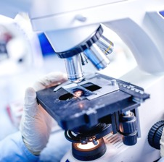


Opportunities and challenges of a lifecycle approach
to EU-level HTA collaboration
Author: First-name Last-name Date: XX/XX/XXXX Version: X (not final)
Ansgar Hebborn

Slide 36
Growing complexity of technology development and regulation
Innovation as driving force of EU-level cooperation on HTA
  Increasing complexity of medicine development and health technologies:
  smaller patient populations, different types of data and evidence, (selectively) accelerated drug development, life-span approach to regulation, fast changing standards of care, critically important co-dependencies between technologies
  Complexity triggers increased interest in HTA as “hurdle” to patient access → growing expectations for earlier engagement between developers, stakeholders and HTA organizations
  Decision makers with different and growing demands from HTA → more and faster and up-to-date
  “one off” HTA less and less relevant for decision making →lifecycle approach, continuous effort and engagement
  Limited (sub-)national HTA capabilities and capacities → increasingly barrier to more timely and equal access in growing number of Member States
  → costs of duplicative (sub-)national HTA activities are growing rapidly

Slide 37
Reducing, not introducing additional complexity
Implications for future EU-level cooperation on HTA
  Our engagement with EUnetHTA (2006-2021) provided invaluable insights about the opportunities, challenges and limitations of EU-level HTA cooperation
  strict focus on activities that replace (sub-)national work → only seamless integration will deliver value in a lifecycle approach
  predictable processes based on common state-of-the-art methodological framework and context-specific evidence expectations → focus on quality, not just lowest common denominator
  functioning interface with EMA in full recognition of different roles
  commitment and capacity to engage with stakeholders throughout a technology’s lifecycle e.g. scientific dialogue opportunities for all companies that request them → most urgent priority going forward
  cross-border collaboration on PLEG and use of RWE in decision making involving all stakeholders
  “above-product” HTA initiatives to efficiently engage with experts and stakeholders on recognized challenges and trends
  balanced “conflict of interest” frameworks to ensure effective integration of expertise (patient and clinician experts, technology developer)

Slide 38


THE EUROPEAN PATIENTS’ FORUM
EUnetHTA Forum 2021
Challenges to the life cycle approach:
The Patient Perspective
Valentina Strammiello
15 April 2021
@eupatientsforum

Slide 39
Take away messages from the FMC (White Paper)
Need for strong support to HTA bodies to facilitate engagement activities
  Our advice is to consider support also to stakeholders (patients and HCPs) to allow sustainable engagement
Patient involvement in the lifecycle approach possible if embedded also in the governance framework
  Strong governance and financial sustainability are key to allow patient involvement
  Our advice: consider deliberative processes as an approach to achieve good and systematic engagement
National models for patient involvement tend to persist, while we need a paradigmatic shift
  We could reach a common approach at EU level

Slide 40
Opportunities
Evolving ecosystem
The new framework for EU level collaboration could learn from other initiatives (HTAi, ISPOR, RWE4Decisions, Regional Clusters etc)
New methods available to inform decision making and meet the need for timely decisions
Patients are increasingly building their expertise and understanding of HTA
  Yet more expertise needed to inform the patient perspective on innovative technologies

Slide 41
Patient involvement in the lifecycle approach
We support the idea of integrating horizon scanning and reassessment
We welcome the practice of involving patients in topics identification in ED
Consider involving patients (POs) in PLEG (registries)
Consider engaging patients as early as possible
Promote continuity of engagement throughout the life cycle to let the patient community have the full picture
Identify profiles requirements and communicate them early and in lay language
Provide a feedback at the end of the procedure
Evaluate and capture impact of PI

Slide 42



Challenges to a lifecycle approach to EUnetHTA’s work: Lessons learned from the current Joint Action
Alex Correia
2021 EUnetHTA Forum

Slide 43
Involvement of multiple stakeholders in the different stages of the medicine life cycle
EUnetHTA demonstrated that synergies between regulators and HTA bodies can be established in different stages of the medicine life cycle, bringing benefits for patients, heath care systems and manufacturers/MAHs;
Different stakeholders (regulators, HTA bodies, payers, patients and clinicians) have overlapping evidence needs and manufacturers/MAHs should engage early with them to fulfil these requirements, to build trust and to optimize the time to market/adoption.
  Horizon Scanning
  Parallel Advice/Early Dialogues, Scientific Advice
  Evidence for JCA(REA) and B/R assessment,
  PLEGs, MEAs, PASS, PAES, Clinical guidelines
  Reassessment

Slide 44
Future challenges and opportunities
  A stable and durable framework of EU cooperation on HTA could further develop the relationship between different stakeholders and the links between HTA activities;
  Allocate resources so that relevant EU HTA products with added value for patients and heath care systems could be delivered – to ensure a sustainable model of HTA cooperation;
  Develop a state-of-the-art common European methodology. HTA bodies should converge to produce the same results using the same information to guarantee robustness and consistency of HTA outputs;
  Collaborate with DARWIN EU (Data Analytics and Real World Interrogation Network) for the development of HTA activities;
  Voluntary collaboration in areas beyond REA such as health economics and Multiple Technology Assessments;
  Cooperate with other EU and international HTA organizations and initiatives.

Slide 45

Challenges to a lifecycle approach to EUnetHTA’s work:
Lessons learned from the current Joint Action
Chantal Guilhaume
Haute Autorité de Santé (HAS)

Slide 46
Challenges related to ED and PLEG activities
Usage of recommendations made during an ED (as a basis for defining the scope of an evaluation) while :
    managing the confidentiality status of the ED
    different HTAb members involvement (ED/JA)
Use EDs to ensure PLEG bridges evidence gap with good quality data
Differences in infrastructure for use and access to real world data among HTAb
Difficulties with data sharing (ownership, timing, legal)

Slide 47
Key word: Anticipation
EUnetHTA output
Parallel procedure with EMA
EMA dossier
submission
Product lifecycle
MAA
CHMP +
Start Pivotal trials
End Pivotal trials
EMA procedure
EUnetHTA Submission dossier
Joint Assessment
1st draft report
Final Joint assessment
EUnetHTA Re-Assessment
Early Dialogue on Pivotal trial & PLEG
Early Dialogue on PLEG
EUnetHTA PLEG arising from HTA
Common Evidence
Gap
Core Minimum data set
Final PLEG report
Registry QUALIFICATION
Registry QUALIFICATION

Slide 48
Support continuum of the exchange
Same approach at each step
  Center on PICO
  Anticipate hurdles for evidence development / evidence gap
  Use same tools (i.e. REquEST to assess registry’s quality)
Insure same level of information for all
  Exchange elements from previous discussions
  Share information on registries qualified and used or planned to be use by EMA and HTAb
Mobilise relevant experts from the beginning and keep them involved throughout the process

Slide 49
Life-cycle approach to collaboration between EMA and EUnetHTA
Reflections based on the experience during Joint Action 3
2021 EUnetHTA Forum, 15.04.2021
Presented by: Michael Berntgen
Head of Scientific Evidence Generation Department

Slide 50
EMA as collaborating partner to EUnetHTA’s work
Key achievements through collaboration along the product life-cycle:
  Prospective guidance on evidence generation programmes, with more than 160 parallel scientific advices since 2010, providing clarity to evidence needed from developers.
  Exchanging views on new products at time of their first authorisation and launch, facilitating mutual understanding of our decisions.
  Collaborations on methodologies, e.g. registry framework and the development of tools such as ReQuest by EUnetHTA, thereby aligning our thinking on these fundamentals.
  Communications through joint publications in scientific journals on key topics, such as the importance of PLEG as well as the similarities of the reviews of orphan medicines.
Strong partnership of our two constituencies due to constructive and fruitful collaboration ➔ we need to continue collaborating based on these achievements

Slide 51
Considerations for future collaboration
Prospective planning of evidence, engagement in methodologies as well as mutual understanding of decision making are paramount.
  European HTA as collaborative partner for regulators, to build the bridge that allows the update of innovation in healthcare systems, in the interest of patients.
  Working together as proactive and open scientific community that embraces new challenges through innovative technologies (eg ATMPs) as well as new types of evidence.
  Building on a robust framework that allows attributing value to a technology from different perspectives that matter for patients, e.g. those with unmet medical needs.
This reflect the understanding that clinical evidence is universal, and that such evidence can serve our respective decision making within our respective remits.

Slide 52
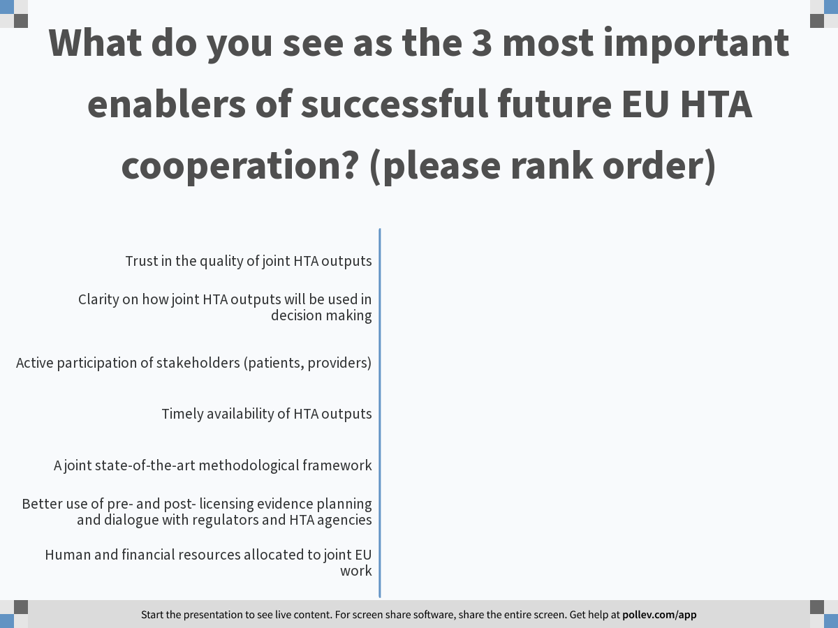
Notes:
Poll Title: Do not modify the notes in this section to avoid tampering with the Poll Everywhere activity.
More info at polleverywhere.com/support
What do you see as the 3 most important enablers of successful future EU HTA cooperation? (please rank order)
https://www.polleverywhere.com/ranking_polls/cQmNPMrHYtXEFhhaHXe6L

Slide 53
Discussion – Panel 1

Slide 54
Break

Slide 55
6. Session 2
Research needs in HTA: What is needed today and what we will need tomorrow
Moderator: Wim Goettsch, ZIN/Utrecht University/HTx

Slide 56







Letter of EUnetHTA to DG Research (2015)
Asking for more research on HTA methodology to support EUnetHTA process
Focus on topics such as:
  Alignment of HTA at different levels
  Additional data collection (RWD)
  Synergy with clinical guidelines
  Organisational research
  Innovative medical devices and advanced technologies
  Transferability of cost-effectiveness
  Patient preferences (PROMS)

Slide 57
Two questions
What will your project deliver in terms of new HTA methods?
What is necessary to implement these methods in daily HTA practice?

Slide 58



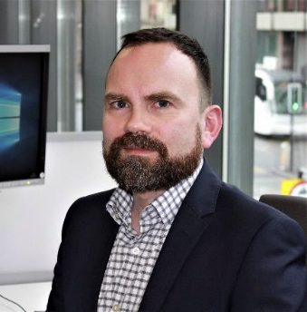

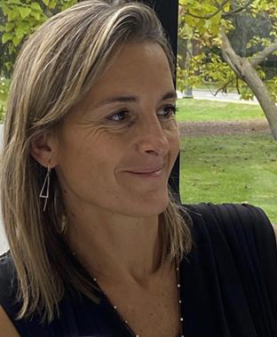

Focus today on overview of current projects but also the future of HTA research
Rosanna Tarricone
Páll Jónsson
Irina Cleemput
Claudia Wild
Panos Kanavos
Inaki Gutierrez-Ibarluzea
Carmen Laplaza Santos

Slide 59
About HTx project
Horizon 2020 project supported by the European Union, kicking-off in January 2019 and lasting for 5 years
15 partners around Europe including universities, HTA, patient and research organisations
Facilitate the development of methodologies to deliver more customized information on the effectiveness and cost-effectiveness of complex and personalised combinations of health technologies.
METHODS
Prediction modelling on the basis of data using different study designs/types such as RCT and RWD
Health-econometric tools to take into account effects and costs in different stages of the life-cycle of the health technologies
Develop artificial intelligence/machine learning methods to forecast individual patient treatment outcomes
CASE STUDIES
Proton therapy for head and neck cancer
Monitoring and treatment pathways in diabetes (T1DM and T2DM)
Pharmacological treatments for relapsing multiple sclerosis (MS)
Different treatment modalities in patients with myelodysplastic syndrome (MDS)
Including development of framework to generalize results to other indications and settings

Slide 60
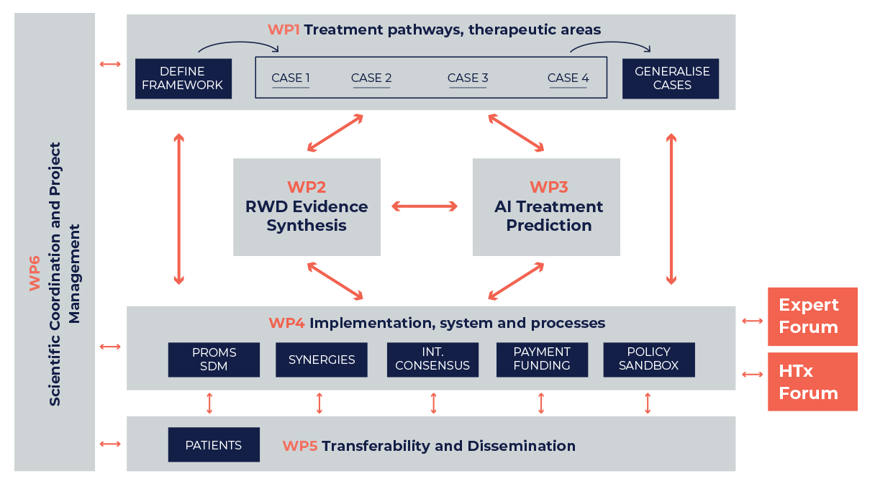

Slide 61

PREFER: Using patient preferences in decision making during the medical product development lifecycle
Oct 2016- March 2022
32 partners
Recommendations on:
  When will / won’t a preference study be useful
  How to assess patient preference studies
  How to use patient preference data in decision making (by regulators, HTA agencies and payers and industry)
  + for researchers: info on preference elicitation methods, points to consider for method selection, psychological instruments, educational tools, working with stakeholders
Disclaimer: This presentation and its contents reflects the view of the presenter and not the view of PREFER, IMI, the European Union or EFPIA.
Notes:
PREFER aims to establish recommendations for industry, regulatory authorities, HTA bodies & payers on how and when to include patient preferences in their decision-making processes along the medical product lifecycle. We do this by identifying, characterising, and applying patient preference elicitation methods
32 consortium members, 16 of which are private companies, 16 public and academic institutions. PREFER runs until March 2022.

Slide 62
Phases when PPI is most likely to be valuable
Medical product discorvery and development
Marketing authorisation
HTA and reimbursment
Post-marketing
Identification of patients’ unmet needs informs choice of clinical trial endpoints
Choice of clinical trial endpoints informs regulatory choice of key benefits
Choice of clinical trial endpoints informs choice of endpoints used in REA
Relative importance of risks and risk-benefit trade-offs inform revision or withdrawal
Inform Patient-Reported Outcome measure scoring
Understand patient’s benefit-risk trade-offs and acceptability of uncertainty
Assess the relative importance of effects on the selected endpoints
Preference study to understand patients’ views on what matters, how much it matters and which trade-offs patients are willing to make
Notes:
PREFER covers all stages of a medical product development life cycle

Slide 63


Pushing the boundaries of existing methods for cost and outcome analysis of medical technologies
Rosanna Tarricone, PhD

Slide 64
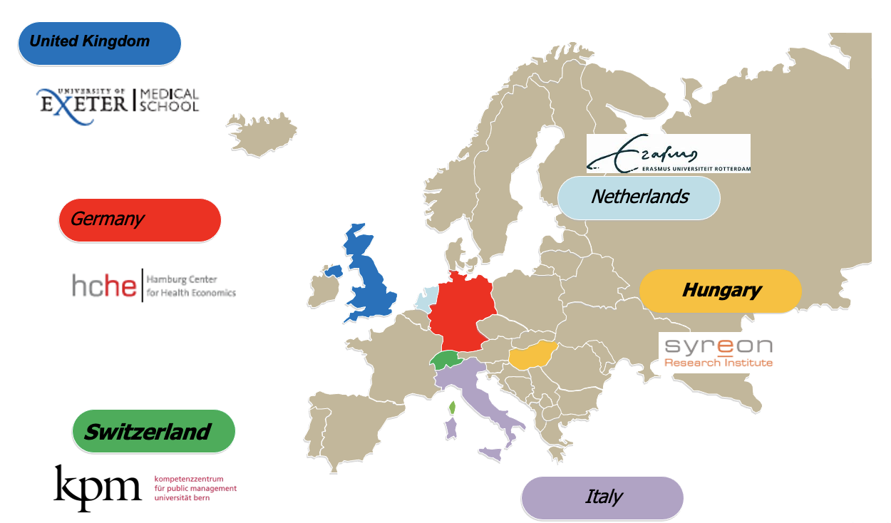
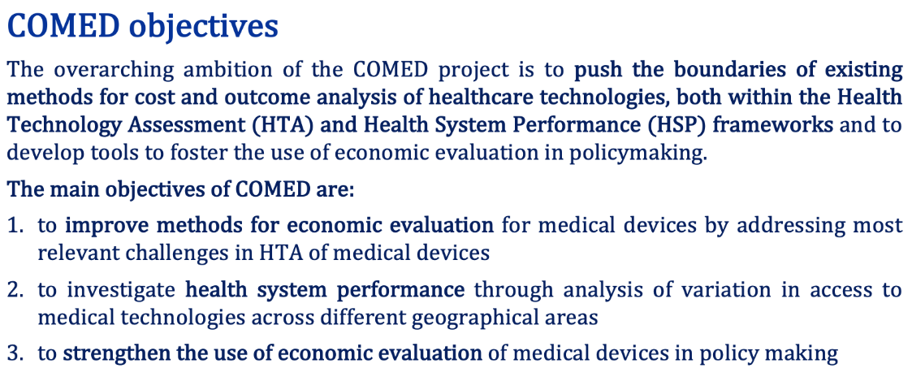
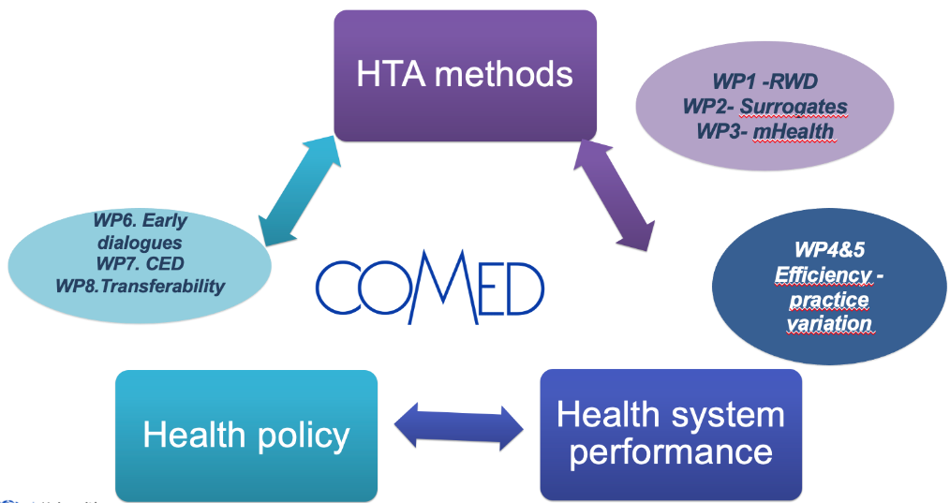

Slide 65
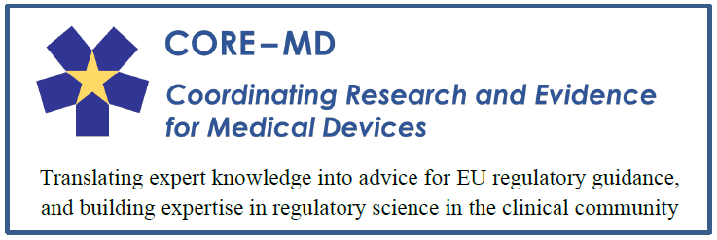

April 2021 – March 2024
Coordination and Support Action 965246
WP1 Understanding methods used to generate clinical evidence for high-risk medical devices
Tasks (examples of relevance for HTA):
Statistical methods for medical device studies
Regulatory utility of patient-reported outcomes
Providing evidence during the early development of high-risk medical devices
New designs for randomised clinical trials and studies of high-risk medical devices
Developing guidance for the evaluation of artificial intelligence and standalone software in medical devices
Clinical evidence generation after market access
WP2 Strengthening evidence for high-risk medical devices: New methods for generating clinical evidence
WP5 Project Management
WP4
Networking and community building
WP3 Extracting maximal value from medical device registries and real-world evidence

Slide 66
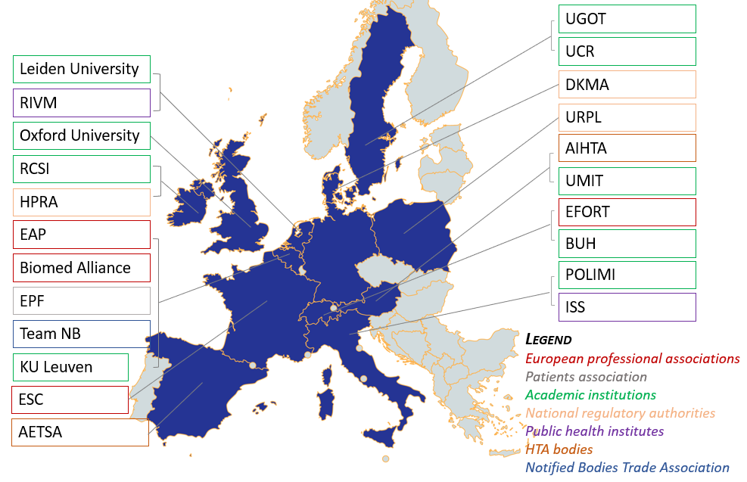





Slide 67
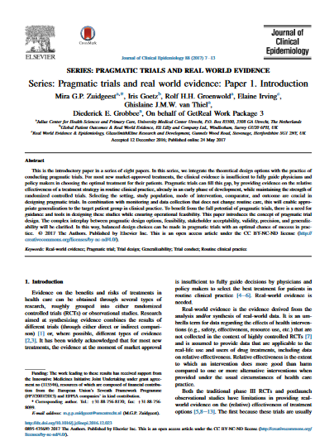
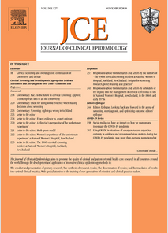
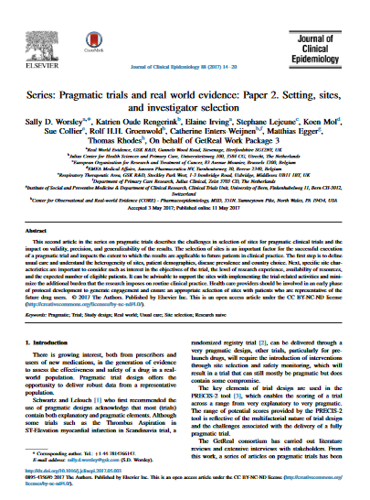
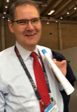
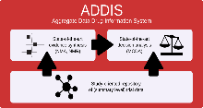


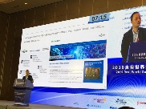












GetReal aimed to show how robust new methods of RWE collection and synthesis could be adopted earlier in pharma-ceutical R&D and the healthcare decision making process
Informing
Decision-Makers
Practical Tools
Skills Development
Global Reach
~40 published research papers on study design, methods, use
“The RWE Navigator clarifies many issues and confusions [and] helps everybody to design better studies.”
— Sebastian Schneeweiss
Highly regarded GetReal Academy offers standard and custom training on study design, methods, and evaluation to a wide range of organizations and individuals, for example:
Brand and influence extend globally, including to Asia-Pacific
Papers and resources regularly cited in regulatory and HTA guidelines and reports, e.g., FDA¹, China CDE², EMA-ENCePP³, MHRA⁴, CADTH⁵
Regulators evaluating potential use of ADDIS tool
Presentation on RWE Navigator at Chinese RWE conference (2019)
TrialTool highlighted at FDA/Duke-Margolis workshop on PCTs
(June 2019)
Panel session with ChinaREAL, highly influential academic-led research network
2013-2017
Original project
30+ scientific papers
Tool development
RWE Academy
June 2018 – April 2021
Refine and promote outputs
Think Tank
Sustainability planning
Launch 28 April 2021
Independent, member-led
non-profit Institute based in the Netherlands

Slide 68




GetReal Institute’s objectives
Serve as the principal European forum for all-stakeholder dialogue, consensus development, and co-creation of solutions to advance use of RWE in health care decision-making
‍Clarify scientific and operational uncertainties in approaches and methods for fit-for-purpose RWD generation, analysis, and interpretation
Facilitate adoption of best practices to enhance the quality and utility of RWE for decision-making
Elevate RWE generation and evaluation capabilities through creation and delivery of trusted, high quality educational content for a diverse range of audiences and skill levels

Slide 69
IMPACT HTA
Panos Kanavos
EUnetHTA Forum 2021
April 15th, 2021

Slide 70
IMPACT HTA - Improved methods and actionable tools for enhancing HTA
IMPACT HTA researches new and improved methods, tools and guidance for decision-makers (across ten thematic areas) aiming at:
  understanding variations in costs and health outcomes within and across countries
  integrating clinical and economic data from different sources to improve methods in economic evaluation in the context of HTA and health system performance measurement
  developing and disseminating a number of innovative methodologies, toolkits and processes aiming to aid decision-making and improve efficiency in resource allocation
 | Partner Institution | Principal Investigator
1 | London School of Economics and Political Science (LSE, UK) | Panos Kanavos
2 | Escuela Andaluza de Salud Publica SA (EASP, Spain) | Jaime Espin
3 | University Castilla-La Mancha (UCLM, Spain) | Julio Lopez-Bastida
4 | Bielefeld University (UNIBI, Germany) | Wolfgang Greiner
5 | National Institute for Health and Care Excellence (NICE, UK) | Pall Jonsson
6 | Instituto Superior Técnico (IST, Portugal) | Monica Oliveira
7 | Paris School of Economics (EEP PSE, France) | Lise Rochaix
8 | Università Cattolica del Sacro Cuore (UCSC, Italy) | Americo Cicchetti
9 | Assistance Publique-Hôpitaux de Paris (AP-HP, France) | Isabelle Durand-Zaleski
10 | Istituto Superiore di Sanita (ISS, Italy) | Marco Marchetti
11 | Università Commerciale Luigi Bocconi (UB, Italy) | Rosanna Tarricone
12 | University of Edinburgh (UEDIN, Scotland-UK) | Karen Facey
13 | Inštitut za Ekonomska Raziskovanja (IER, Slovenia) | Valentina Rupel
14 | Agencja Oceny Technologii Medycznych i Taryfikacji (AOTMiT, Poland) | Aneta Lipinska
15 | Tandvårds- och läkemedelsförmånsverket (TLV, Sweden) | Douglas Lundin

Slide 71
IMPACT HTA – Core Work Packages
WP2- Development and application of a tool to combine and use RCT and observational /registry data in economic evaluation (DICE application)
WP3- Developing a costing methodology and a core dataset of costs for facilitating cross border comparisons in economic evaluation
WP4- Social costs and their role in economic evaluation for health care decision-making
WP5- Exploring health preferences on different sub-population groups using EQ-5D
WP6- Methodological guidance on the analysis and interpretation of non-randomised studies to inform health economic evaluation
WP7- Methodological tools using multi-criteria value methods for HTA decision-making
WP8- Analysis of economic evaluation methods for hospital-based assessment
WP9- Expanding economic analysis for HTA: methods for measuring fiscal impact of new healthcare interventions
WP10- Guidance to support consistent HTA appraisal for orphan medicinal products
WP11- Decremental cost-effectiveness and behavioural aspects in decision-making

Slide 72


IMI-PARADIGM
EUnetHTA FORUM 2021
PARADIGM is receiving funding from the Innovative Medicines Initiative Joint Undertaking 2. This Joint Undertaking receives support from the European Union’s Horizon 2020 research and innovation programme and EFPIA.

Slide 73


IMI PARADIGM
Promoting the adoption of practices by stakeholder groups by creating a ‘lowest common denominator’ of expectations for effective engagement.
Engagement capability, capacity building and sustainability: identifying specific resource needs and mobilisation potential for each stakeholder to further advance implementation of meaningful patient engagement practices across disease states and diverse patient groups;
Rules of engagement: developing resources to enable engagement (the “how to engage”) focusing on the three selected phases of the medicines life cycle and taking into account the particular needs of the selected vulnerable populations;
Ensuring strategic and extensive outreach to a broad set of stakeholders within the medicines development community at large and engage with relevant initiatives and projects to ensure optimal synergies and cross-fertilisation, while avoiding duplication of efforts;

Slide 74
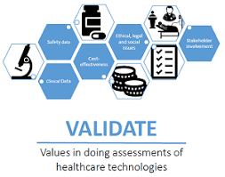

Other non-mentioned projects
VALIDATE-HTA (value and values within HTA process)
  Erasmus Plus
  https://validatehta.eu/
EXACT (Framework for the assessment of OMICs technologies)
  Marie Slodowska Curie

Slide 75
Research on HTA in Horizon Europe
EUnetHTA Forum
15 April 2021
Carmen LAPLAZA SANTOS &
Leslie PIBOULEAU
DG Research & Innovation
#HorizonEU

Slide 76





4 HTA research projects under H2020
€ 3 million
01/18-06/21
€ 9.6 million
01/19-12/23
Pushing the boundaries of Cost and Outcome analysis of Medical Technologies
Next Generation HTA to support patient-centred, societally oriented, real-time decision-making on access and reimbursement for health technologies throughout Europe
€ 4.6 million
01/18-06/21
Improved Methods and Actionable Tools for Enhancing Health Technology Assessment
1 Coordinating & Support Action on regulatory science
€ 3 million
01/18-06/21
€ 2.4 million
04/21-03/24
ProgrammE in Costing, resource use measurement and outcome valuation for Use in multi-sectoral National and International health economic evaluAtions
Coordinating Research and Evidence for Medical Devices

Slide 77










IMI research projects on HTA
Big Data for Better Outcome (BD4BO) Programme

Slide 78



EU R&I Framework Programme (2021-2027) Horizon Europe
€ 95,5 bn
Structured around three pillars and one horizontal activity:
Pillar 1
Excellent Science
Pillar 2
Global Challenges and European Industrial Competitiveness
Pillar 3
Innovative Europe
European Research Council
Health
Culture, Creativity and Inclusive Society
Civil Security for Society
Digital, Industry and Space
Climate, Energy and Mobility
Food, Bioeconomy, Natural Resources, Agriculture and Environment
European Innovation Council
Marie Skłodowska-Curie Actions
Clusters
European innovation
ecosystems
European Institute of Innovation
and Technology
Research Infrastructures
Joint Research Centre
Widening Participation and Strengthening the European Research Area
Widening participation and spreading excellence
Reforming and Enhancing the European R&I system

Slide 79
Cluster Health – 6 challenges
1. Staying healthy in a rapidly changing society
2. Living and working in a health-promoting environment
3. Tackling diseases and reducing disease burden
4. Ensuring access to sustainable and high-quality health care
5. Unlocking the full potential of new tools, technologies and digital solutions for a healthy society
6. Maintaining a sustainable and globally competitive health-related industry
  See for a detailed description:
  https://ec.europa.eu/info/files/orientations-towards-first-strategic-plan-horizon-europe_en

Slide 80
Destinations relevant for HTA
Destination 4: Ensuring access to sustainable and high-quality health care
- Innovative full health technology assessment methods (i.e. including all relevant aspects such as clinical effectiveness, cost-effectiveness, ethics, organisational aspects, etc.) to support better allocation of resources.
Destination 5: New tools, technologies and digital solutions for a healthy society
Destination 6: Maintaining a sustainable and globally competitive health-related industry
- Novel methodologies adapted to new technologies and interventions for their assessment, validation, integration into regulatory frameworks and translation into health care practice
- Better methodologies and interdisciplinary approaches to assess new health technologies and interventions

Slide 81
Instruments to implement research on HTA
Traditional collaborative calls
https://ec.europa.eu/info/funding-tenders/opportunities/portal/screen/programmes/horizon
Partnerships
  Innovative Health Initiative (IHI)
    Public-private institutionalised partnership:
    Successor of IMI but with broader scope and partner composition
    Based on a Regulation currently under discussion at the Council
    First calls expected to be launched end of 2021
  Partnership on Transforming Health and Care Systems
    Public-public cofunded partnership based on a grant agreement between the EC and a consortium of partners
    Call planned for the Work Programme 2021-2022
    Tentative operational start in 2023
  Partnership on Personalised Medicine
    Public-public cofunded partnership
    Plan for the Work Programme 2023-2024

Slide 82
Innovative Health Initiative (IHI)
  Partnership between the EU represented by the Commission and 5 health related industries (pharma, medical devices, diagnostics incl. health ICT, biotech, vaccines)
Proposed budget: € 2.4 billion in total (€1.2 billion from the EU to be matched by €1.2 billion from the industries and contributing partners)
  Openness to new ideas from external stakeholders: governance adapted to incorporate views of various stakeholders, in particular ideas for research topics

Slide 83
IHI - Potential research areas related to HTA
  IHI overal objective: Foster cross-sectoral collaboration to facilitate the integration of various technologies into health care solutions able to respond to people needs and preferences
    → focus on:
    Integrated health care solutions (for better prevention, diagnostic, treatment, health management)
    People-centricity
  → that would would call for research on new methods:
    to assess the added value of those integrated health care solutions
    to better involve people from the design of a health solution to its implementation in health care
  IHI Strategic R&I agenda currently under discussion between the EC and the 5 industry associations

Slide 84
Conclusion
    HTA bodies highly encouraged to engage in HTA research:
    Feedback on research needs and suggestion of topic ideas both for IHI and collaborative research calls (next Horizon Europe Work Programme 2023-2024)
    Feedback on barriers to test/implement research outputs in HTA practices
    Participation in research projects
      Research and innovation actions (RIA) or Coordinated and Support Action (CSA)
      Funding rate: 100% of eligible costs in RIA and CSA of collaborative calls and IMI/IHI calls
      Horizon Europe Work Programme 2021-2022 to be published soon https://ec.europa.eu/info/funding-tenders/opportunities/portal/screen/programmes/horizon

Slide 85
    Thank you!
#HorizonEU
http://ec.europa.eu/horizon-europe

Slide 86
Discussion – Panel 2

Slide 87
Break

Slide 88
7. Session 3 | Panel
EUnetHTA: The past, the present and the future -Lessons learnt and recommendations
Moderator: Marcus Guardian, ZIN

Slide 89

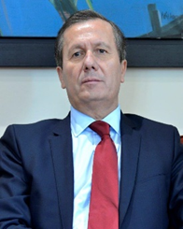

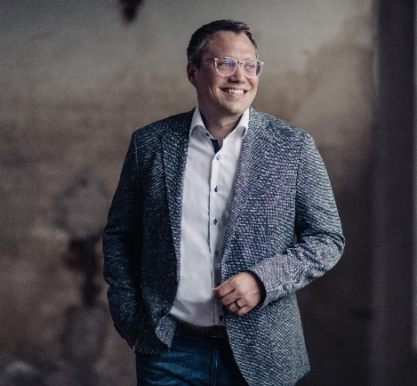

Panellists
Anna Eva Ampelas,
European Commission (DG SANTE)
Niklas Hedberg,
TLV/ EUnetHTA
Rui Santos Ivo,
EU Council Presidency
Tiemo Wölken, MEP/EP Raporteur
Yann Le Cam, EURORDIS

Slide 90
Discussion – Panel 3

Slide 91
8. Video: The EUnetHTA Journey

Slide 92

Video: EUnetHTA JA3 “ A Journey”

Slide 93
9. Closing remarks
Niklas Hedberg, TLV

Slide 94
Digital Group Photo

Slide 95
2021 EUnetHTA Forum
End of session

